Slide 1
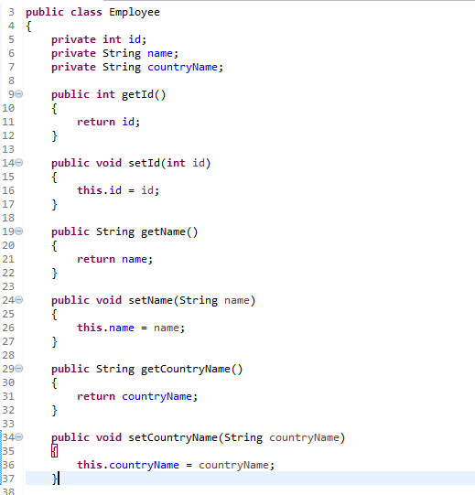
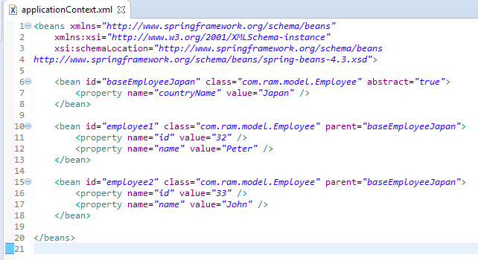
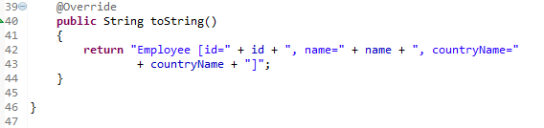
Spring bean configuration for inheritance with abstract
In Spring, the inheritance is supported in bean configuration for a bean to share common values, properties or configurations.
A child bean or inherited bean can inherit its parent bean configurations, properties and some attributes. In additional, the child beans are allow to override the inherited value.
Above is a ‘baseEmployeeJapan’ bean contains a ‘Japan’ value for countryName property, and the ‘employee1’ and ‘employee2’ beans are inherited this value from its parent (‘baseEmployeeJapan’).
If you want to make this base bean as a template and not allow others to instantiate it, you can add an ‘abstract‘ attribute in the <bean> element.

Slide 2
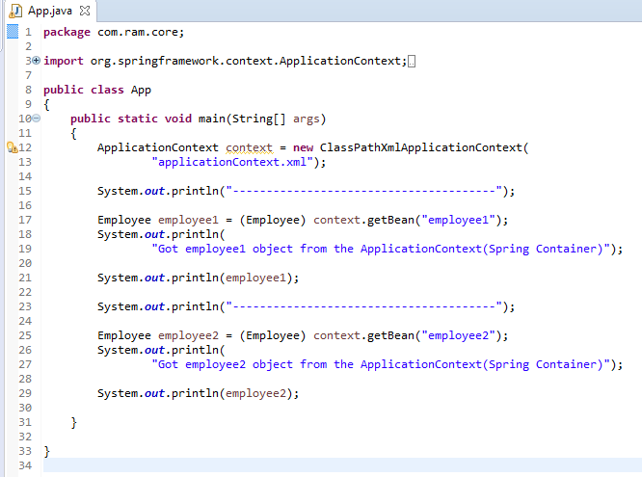
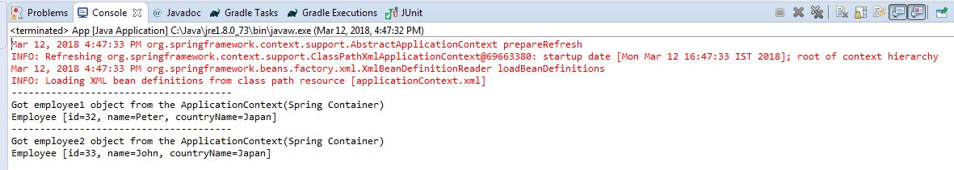
Spring bean configuration for inheritance with abstract

